Slide 1

Smart Contact Manager
Presentation Overview

Slide 2

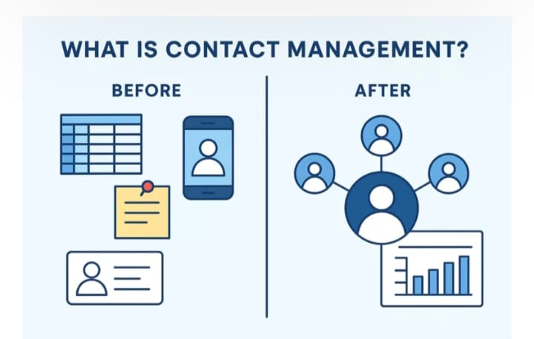
Introduction
Smart Contact Manager is a system used to store and manage contact details like name, phone number and email.

Slide 3

Objective
The objective of this system is to manage contacts efficiently and allow quick access to contact information.

Slide 4

Problem Statement
Managing contacts manually or across multiple apps can be difficult and time‑consuming.

Slide 5
Proposed Solution
Smart Contact Manager provides a centralized system to store and organize all contacts.

Slide 6

System Features
• Add Contacts
• Edit Contacts
• Delete Contacts
• View Contact List
• Search Contacts

Slide 7

Contact Storage
All contact details are stored securely in a database for easy retrieval.

Slide 8

Search Function
Users can quickly search contacts using name, phone number or email.

Slide 9
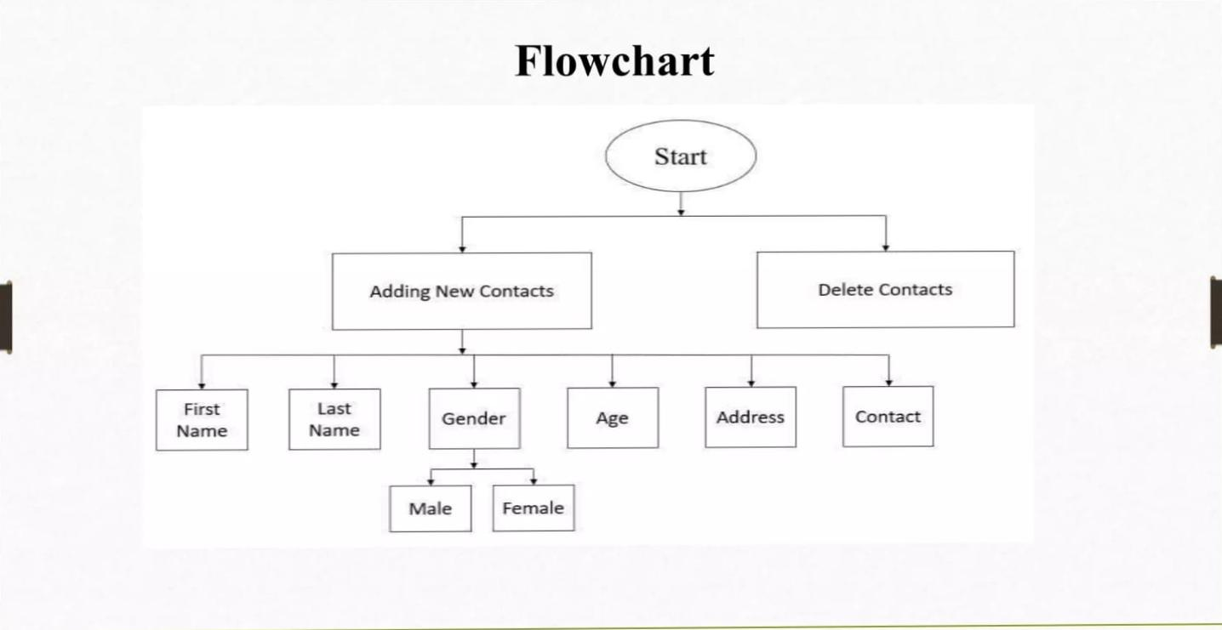
User Interface
The system provides a simple and user‑friendly interface for easy navigation.

Slide 10

Mobile Accessibility
Contacts can be accessed from mobile devices anytime.

Slide 11

Cloud Synchronization
Contacts can be synchronized across devices using cloud technology.
Feature | Description | Examples
Real-time Sync | Automatic updates accross iCloud, Google, cardDAV without manual refresh | Cloud contacts app, personify
Multi Device support | Desktop/mobile/ web access with offline mode fallback | Smart contacts (Google Play, GitHub SCM projects
Back-up and restore | One tap cloud backups to Google Drive/Dropbox,auto-dupe merge | Contacts+, Contact book
Security | End-to-end encryption,ni middleman servers | Role-based auth in cloud CRMs

Slide 12

Security
User authentication and secure storage protect personal data.

Slide 13
Advantages
• Saves time
• Easy contact management
• Secure data storage
• Organized contact list

Slide 14
Applications
Used in personal contact management, business directories and customer management systems.

Slide 15
Conclusion
Smart Contact Manager simplifies contact organization and improves accessibility.

